Slide 1
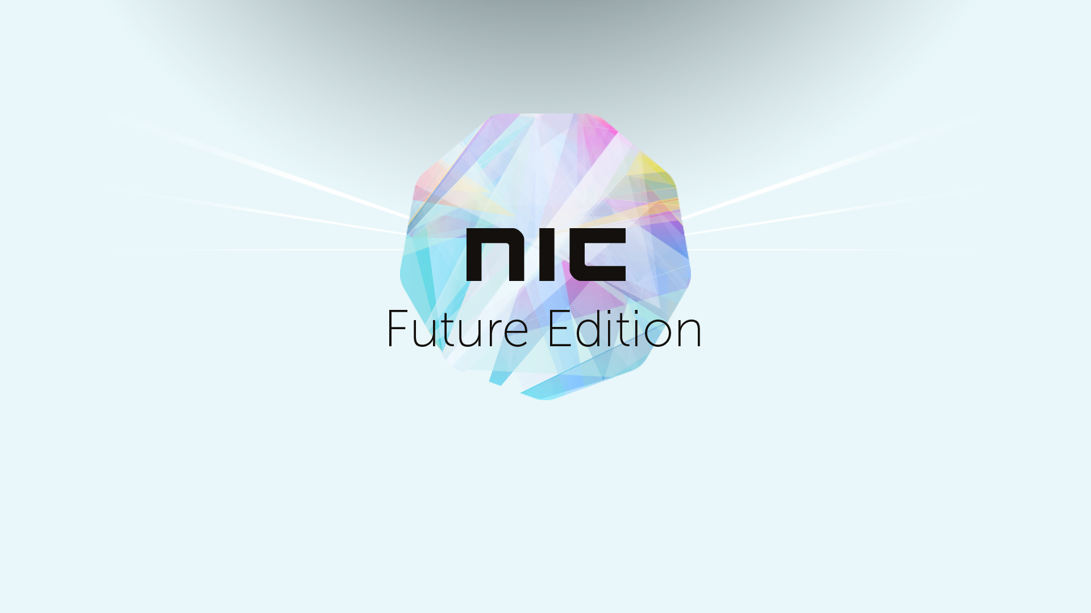
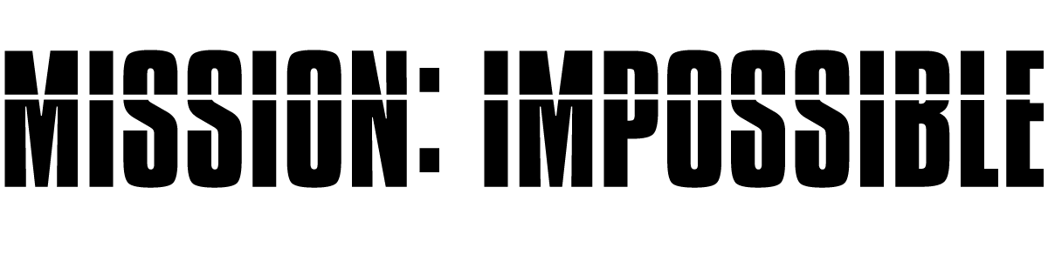
Achieving productivity without an on-prem infrastructure

Slide 2


Introduction
Raymond P.L. Comvalius
Independent IT architect for 19 years
… works with Windows
Sander Berkouwer
Senior Consultant at SCCT scct.nl
… works with Active Directory

Slide 3
What’s the mission?

Slide 4
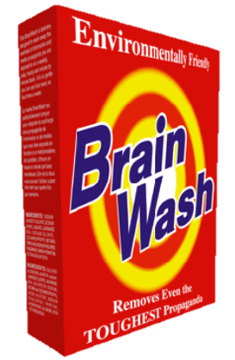
Is the cloud a mission?
Notes:
Scale of the cloud has proven to do more than just cost savings
Cloud providers do a lot of things better than most companies:
Scalability
Systems Management
Monitoring
Updating
Using knowledge at scale for AI and machine learning
Better uptime
Multiple regions

Slide 5

Problem!?
Notes:
But your management probably only knows of one problem to solve with the cloud: The hidden cost of on-prem infrastructure

Slide 6
Cloud VM instance forecast
On-prem
Cloud
Forecast, 2016

Slide 7
Total cost of ownership

Slide 8
Goal of the mission?
Money
Security
Mobility
Flexibility
Notes:
Not just the money
Cloud is becoming proven technology
But not for everything

Slide 9
Moving Your Assets

Slide 10
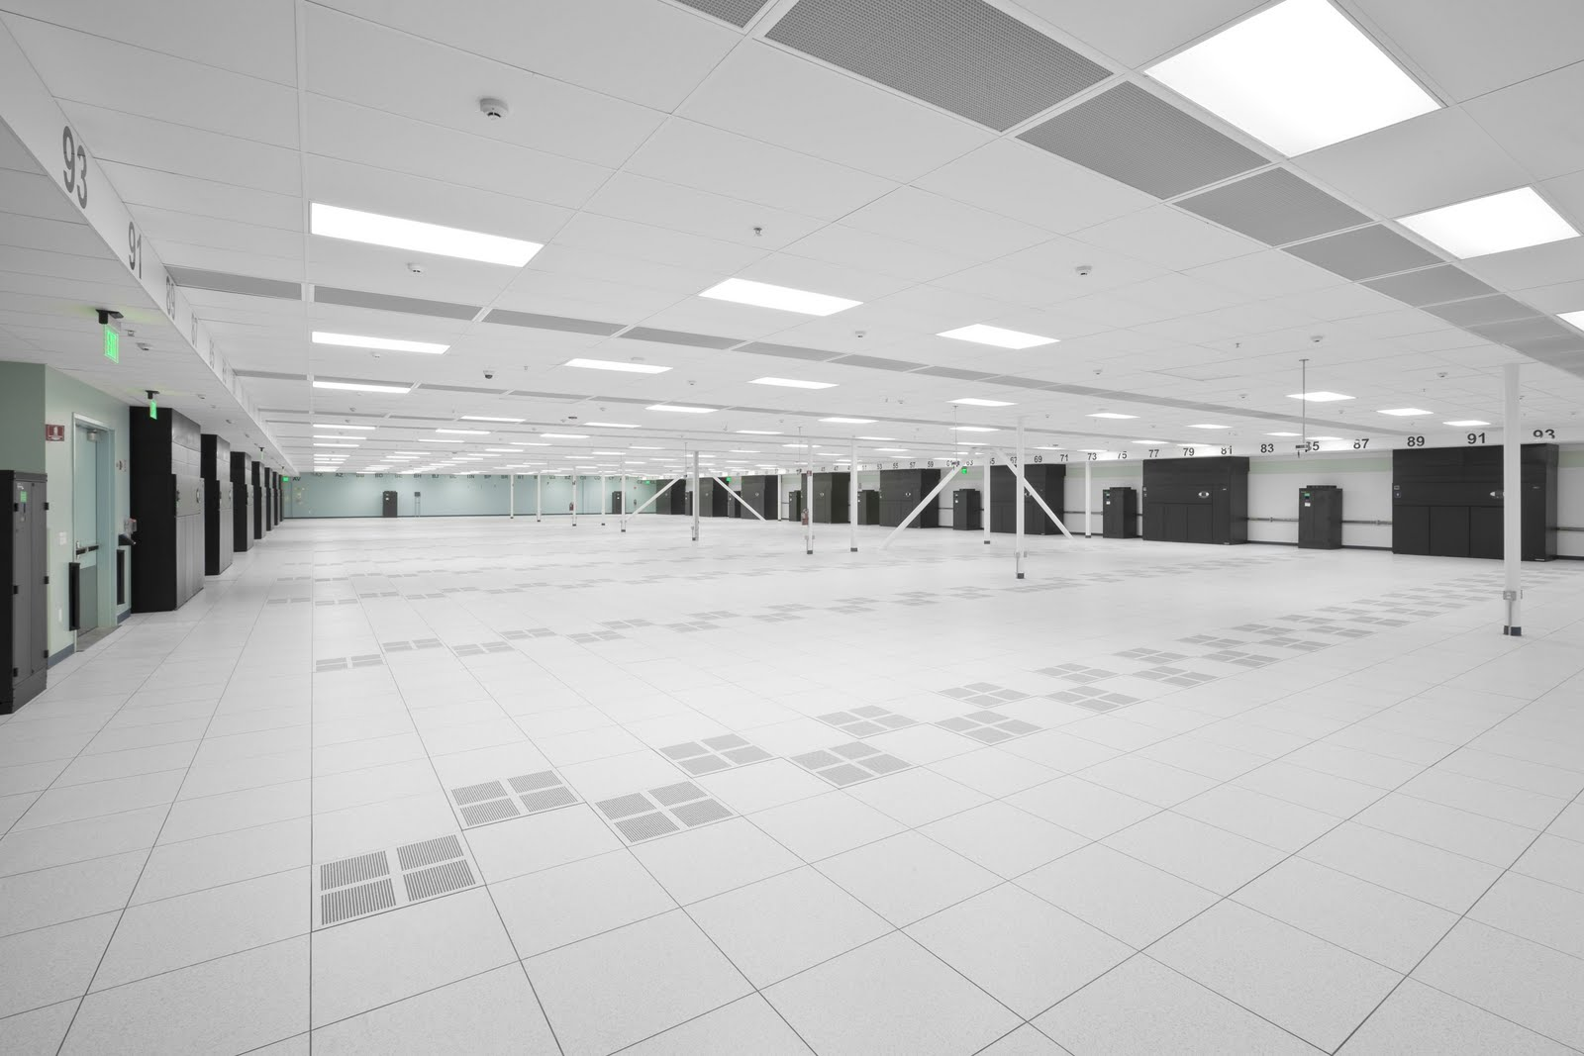
Lift and Shift
Notes:
Choose the right workloads
Is there an exit strategy?
Azure Site Recovery as a strategic solution
It’s about digital transformation

Slide 11
Datacenters
Current: Outsourced
Recommendation: Azure PaaS (IaaS)
Virtual Machines hosted by your IT department or an outsourcer, like HPE and managed by you or another outsourcer, like TCS.
Typical scenarios:
Rarely scalable
Mostly overcommitted
Lenient SLAs
Check vendor support KB2721672 Link
Leverage Platform-as-a-Service
Azure SQL Database & Cosmos DB
Azure VPN Gateway
Axure App Service
Azure Key Vault
Etc.
Or rely on Infrastructure-as-a-Service for hard workloads like SAP and your other Line of Business (LoB) apps

Slide 12
The management stack
Applications
Applications
Data
Data
Runtime
Typically
Outsourced to TCS and the likes….
Runtime
Middleware
Middleware
Operating System
Operating System
Virtualization
Typically
Outsourced to HPE and the likes….
Virtualization
Azure Infrastructure as a Service
Servers
Servers
Storage
Storage
Networking
Networking

Slide 13

Identity
Notes:
NTLM and Kerberos are dead
Trusts smell like hairy donkey balls
The internal network is not safe. It never was…
What’s the right way to start? It depends….
You probably already have your identities in the cloud
MFA

Slide 14

Office Productivity
Notes:
Exchange Online was/is the starting point for many
Office Professional Plus is next
Costs for upgrades are gone
The whole experience counts
No option to bail out on upgrades
Control over license use may be an issue
Unified communications

Slide 15

Enterprise File Sharing
Notes:
SharePoint online
OneDrive
Azure Files

Slide 16
File Services
Current: Windows File Servers
Recommendation: SharePoint Online
File Servers hosted by your IT department or an outsourcer, like HPE and managed by you or another outsourcer, like TCS.
SMB1 still enabled most of the time…
Distributed File System (DFS), File locking dependencies and Access-based Enumeration common in larger deployments and infrastructures
Excessive delegation of file and folder permissions even in the smallest of environments.
SharePoint Document Libraries
Automatic versioning of files
Metadata enhancements
OneDrive for Business for local sync
Recommendation: Azure File Sync Preview
Centralize File services in Azure Storage
Cache frequently accessed files for fast local access and Storage Tiering
Not an alternative: Azure File Share

Slide 17

Desktop Computing
Notes:
Days of OS deployment are over
AutoPilot
Windows Store for Business
Domain Join to Azure Domain Join
Conditional Access
Az

Slide 18
Four ways to go to Azure AD in Windows 10
OUT OF THE BOX EXPERIENCE
Azure AD
tenant
1
SETTINGS, ACCOUNTS
Windows 10 device
2
3
AD FS REGISTERED
4
AZURE AD CONNECT SYNC’ED
Active Directory
Domain Services
DOMAIN-JOINED
Windows device

Slide 19

Relying Party Trust
5
cert
Synchronization
Azure AD
tenant
Claims Issuance Rules
12
Azure AD Connect
13
1
claim
4
Active Directory
Federation Services
7
6
i
10
3
Service Connection Point
11
*****
Group Policy refresh
2
Group Policy
Windows 10 device
Group Policy
Active Directory
Domain Services
Cert
TPM
Store
8
9

Slide 20

Workspace 2020
Notes:
Not just Windows
Modern Management

Slide 21
Recommendations for azure AD Join
Use Intune
Azure AD Join & Domain Join ++ give IT departments control
Intune makes sure IT departments stay in control
Device limits
End users can Azure AD Join an unlimited amount of devices, default is 20.
Intune’s license limit is 15 devices, but default is 5. Change it when needed
Pre-registration can prevent non-approved devices from being managed
Local Admin rights
Azure AD Join is for BYOD scenarios, so joiner keeps admin rights
… fortunately you can always specify more local admins in Azure AD…
Domain Join ++ enforces the admin privileges of Active Directory

Slide 22
Device Management
Current: Group Policy & ConfigMgr
Recommendation: MDM & MAM
‘Sneakernet’ won’t work in the cloud
Group Policy for domain-joined Windows devices only, not for Macs, etc. *
System Center Configuration Manager offers enterprise client management and Internet-based management capabilities, using on-premises protocols
Management for any device, even Windows Phones and BlackBerries
Mobile Device Management (MDM) for complete control over device, useful for CYOD scenarios
Mobile Application Management (MAM) for complete control over applications and their data, useful for BYOD scenarios

Slide 23

.
Application Distribution
Notes:
Cloud based app stores and web apps are the ideal solution
App-V from the cloud?
Cloud based VDI/RD

Slide 24

Networking
Notes:
Express Route
When to use and when not to use

Slide 25
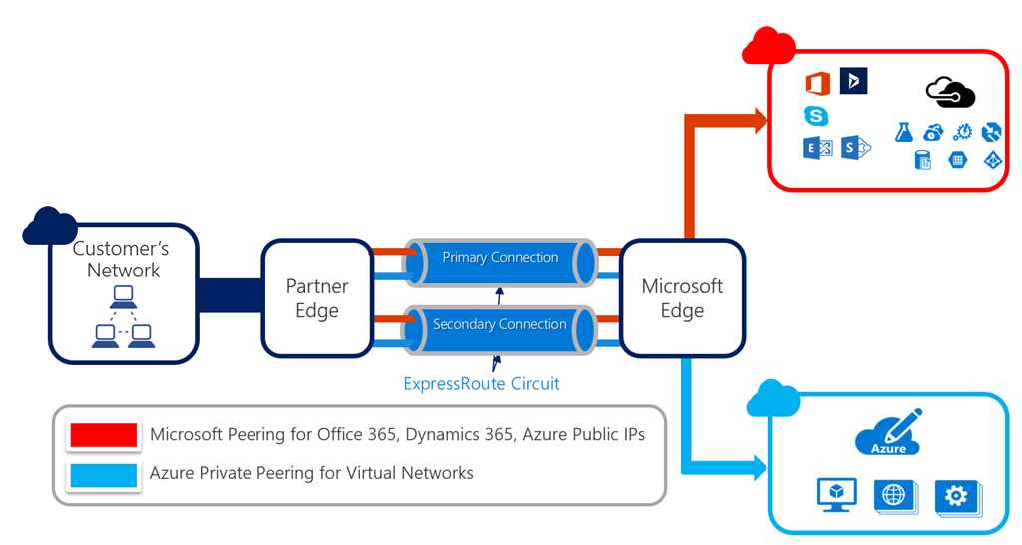
ExpressRoute
Notes:
Express Route is not for authentication traffic

Slide 26

Usage
BYO/CYO/COPE – Who Owns
Services
Notes:
Printing

Slide 27
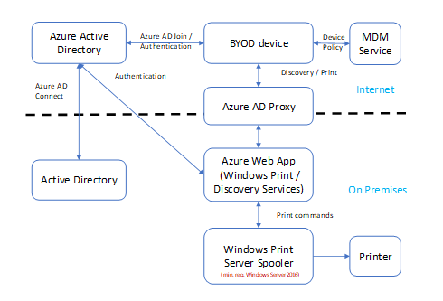
Printing and Scanning
Current: Windows Print Servers
Recommendation: Hybrid Cloud Print
Print Servers hosted by your IT department or an outsourcer, like HPE and managed by you or another outsourcer, like TCS.
32bit, 64bit Printer drivers
Excessive delegation of printing permissions, default printer selections, etc.
New feature in Windows Server 2016
Windows Print Service
Discovery Service
Azure AD as Identity Provider, Discovery endpoints registered with Azure AD, MDM as provisioning mechanism
Seamless side-by-side transition
Azure AD App Proxy for external access

Slide 28

Backup
Notes:
Azure Site Recovery

Slide 29

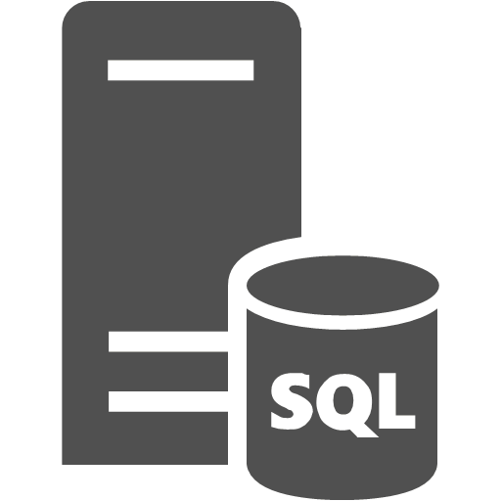
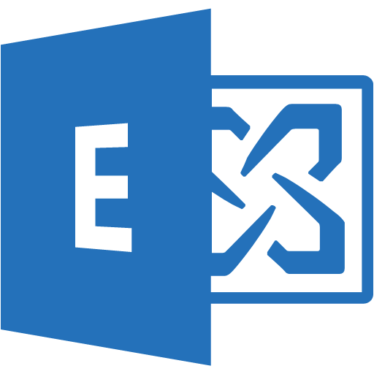
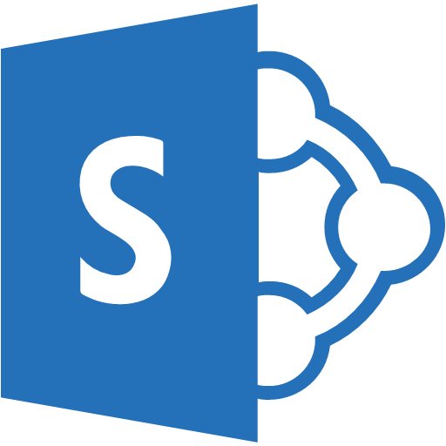
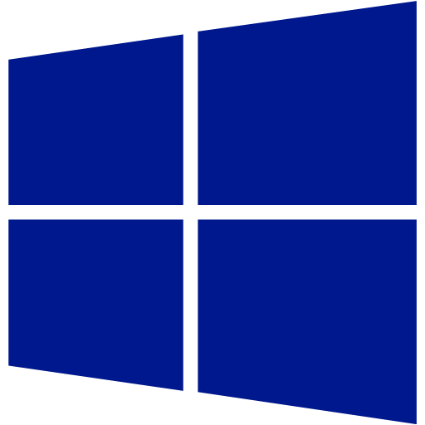


DPM overview
SC DPM
Azure Backup Recovery Services Vault
Disk Storage
App Consistent
Azure
SQL Server
Exchange
SharePoint
File Server
Physical
Hyper-V VMs
VMware VMs
Hyper-V
VMware
Private Cloud protection at scale
Cloud Integrated Backup
Application Aware Backup
Central monitoring and Reporting
Automation

Slide 30

Concluding
Notes:
Did we just do it?
What are the big challenges?
Upgrades
Legacy apps
VDI/Remote Desktop

Slide 31

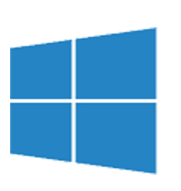
Office365
Azure
Azure AD
Domain Services
Synchronization
Azure AD
tenant
Intune
On Premises
Azure AD Connect
Active Directory
Domain Services
ConfigMgr
Exchange Servers
SharePoint Servers
Application Servers

Slide 32





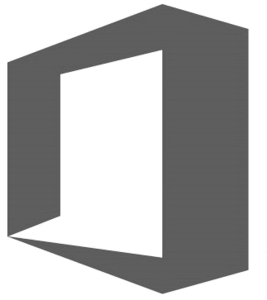
Where do you start? Where does it end?
End-user computing
Modern Management
Line of Business apps
IaaS, PaaS & Serverless
HYBRID
On-premises productivity
Office 365

Slide 33
Infrastructure that remains on-premises
Client computers, just not on a ‘safe network’
Network components like switches, routers, Wi-Fi hotspots, simply because they provide bandwidth
A firewalled Internet connection
Printing and scanning
File Server access
… straight from the VDI and RDS playbook.

Slide 34
The really hard parts
Call centers in terms of telephony
Active Directory * Services, because of physical access
SIEM and auditing solutions
DHCP & the Last Mile
2-Cloud & Exit Strategies

Slide 35
Achievements
Money
Security
Mobility
Flexibility

Slide 36
Resources
Slides and demos from the conference will be available at github.com/nordicinfrastructureconference/2018 (bit.ly/2y7JhA3)

Slide 37


Slide 38
Our lessons learned
Cloud doesn’t change anything, but digital transformation does.
Moving servers to IaaS only makes sense for the last couple of ‘em.
Either way to move to the cloud makes sense as a primary objective:
Identity and modern management
Productivity and modern apps
The modern Datacenter
On-premises is far from dead for a lot of organizations.

Slide 39
Thank you!

